Slide 1

SQL Server Admin Best Practices with DMV's
DBA Fundamentals Virtual Meetup Group
William Assaf Microsoft
Notes:
An incomplete tour of SQL Server DMV’s, covering the most important topics and getting you started on getting the most you can out of these crucial performance indicators.
Today’s presentation is delivered with a short delay from the broadcast medium, so if you have any questions, go ahead and submit them any time, and we’ll save time to answer collected questions and at the end.

Slide 2
Getting Started
Audience
Purpose
Questions at middle and end
Slides posted at SQLTact.com
Labs in Toolbox on Github: github.com/sparkhoundsql/sql-server-toolbox
Notes:
<read notes>
Everyone can benefit from knowledge of these helpful tools, from developers to report writers to DBA’s of all levels of experience.
<next>
There are far too many DMVs to be covered in the scope of this presentation, here are the most useful and popular.
Getting anything out of DMVs will require you to try them yourself.
Short, quick-hitting labs throughout. We won’t get to all Labs, but you can!
Share practical, everyday uses and scripts.
If you’re the type who wants to write your own diagnostic queries, explore the internals, design your own maintenance, this presentation is for you.
If you didn’t think it was possible to do such things, this presentation is for you.
If you use someone else’s maintenance or diagnostic queries but want to understand them better, this presentation is for you.
<next>
I’ll stop for questions in the middle briefly, and then save time for questions at the end as well.
<next>
Yep, slide and all code samples will be posted at my blog at SQLTact.com
<next>
A lot of the code for this presentation is straight from my old consulting team’s still updated SQL Toolbox on Github, it’s out there for everyone’s reference here for free.

Slide 3
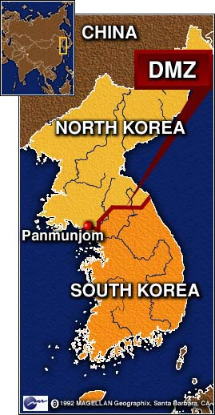

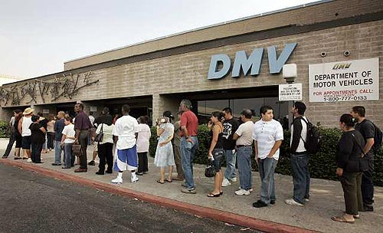




What Is a DMV?
Dynamic Management Views are in place to provide system transparency.
Most DMO’s work back to SQL 2005 (90).
New DMV’s in recent SQL versions as noted.
Notes:
<slide first>
The DMV’s we are talking about today are the foundation of countless third party SQL monitoring applications.
They all fall into a category of DMO’s.
Some are DMF’s, table-valued Functions with parameters.
For these purposes, we will call them all DMV’s, because we can make more jokes about DMV’s.
They could also be called DMO’s, Dynamic Management Objects, but that acronym is already taken by Distributed Management Objects.
<next>
Some database-level DMV’s require the database to be in the needed compatibility mode or higher, some do not.
Some towards the end of the presentation have been introduced more recently, including some in SQL Server 2019 that we’ll call out specifically.
Often, DMV changes are included for older versions via Service Packs or Cumulative Updates, so something may only work in SQL 2012 SP4, but not before.
Most of this content applies to SQL Server, all service level objectives of Azure SQL, SQL on Linux, and Azure SQL Managed Instance, with few exceptions.

Slide 4
Permissions
Most DMV’s require only:
VIEW SERVER STATE
or
VIEW DATABASE STATE
grant view server state to [domain\william.assaf] grant view database state to [domain\william.assaf]
Notes:
These are read-only permissions that may be appropriate for developers in prod.
Now, what have I done wrong here, already? Don’t grant permissions to individuals of course, but rather to security groups in Active Directory, get in that habit.
<optional>
For a lot more on best security practices, I’ll be giving a presentation on Security Principals 101 tomorrow at the Database Professionals Virtual Meetup Group online, you can check that out on my blog as well.

Slide 5
Ready?

Slide 6
wait_stats DMV’s
Wait Stats can be powerful diagnostic tools.
dm_os_wait_stats - Aggregate for the Instance
dm_os_waiting_tasks – Live Sessions
dm_exec_session_wait_stats – Aggregate Session
Notes:
Many performance suites do little more than incorporate Wait Stats data for charts in their dashboards, but they also are great sponsors of user groups and tech events!

Slide 7
sys.dm_os_wait_stats
Aggregated wait times – records when something has to wait and retains it.
Records count of tasks experiencing the wait type, sum of time and max time waiting.
There are 1000+ (more or less documented)
wait types in SQL 2019.
Notes:
<read slide first>
We are actually working to document more and more of these continuously.
Now, most of these aren’t that important or common, and it’s best to exclude types that match ‘%SLEEP%’ because those are related to db system startup waits or background task waits and shouldn’t be considered part of user performance.
In fact there are a bunch of wait types to ignore…

Slide 8
sys.dm_os_wait_stats
ONDEMAND_TASK_QUEUE – high wait times of this type indicate lots of SQL Server idle time. Disregard.
These wait times also indicate idling and are not problematic:
BROKER_TRANSMITTER BROKER_RECEIVE_WAITFOR DBMIRROR_WORKER_QUEUE KSOURCE_WAKEUP CLR_AUTO_EVENT LOGMGR_QUEUE REQUEST_FOR_DEADLOCK_SEARCH QDS_SHUTDOWN_QUEUE
and many many more..
Good resource here: https://www.sqlskills.com/blogs/paul/wait-statistics-or-please-tell-me-where-it-hurts/
Notes:
Let’s talk about some common waits…

Slide 9
sys.dm_os_wait_stats
LCK_M_* - Lock waits
This is a sign of transaction contention.
Observe sys.dm_tran_locks over time
Could be that poor queries/indexing are creating too many scans, scans that block other requests.
Synchronous Availability Group replicas could increase.
Lots of LCK_M_ waits? Consider RCSI – Read Committed Snapshot Isolation instead of NOLOCK

Slide 10
sys.dm_os_wait_stats
CXPACKET – clear indication of excessive execution plan parallelism and CPU is struggling.
Look into MAXDOP settings, it may be appropriate to reduce large parallel queries from impacting performance
MAXDOP can be configured server-wide, but also in recent versions of SQL, at the query or database level.
Enforcing MAXDOP is one of the better implementations of the Resource Governor (Enterprise-only)

Slide 11
sys.dm_os_wait_stats
CXPACKET has split into CXPACKET & CXCONSUMER
CXPACKET used to be from threads that both consume and produce data in query plan.
Producer threads were most problematic, most impacted by the parallelism, and most affected by out-of-date statistics. Now, only producer threads are reported by CXPACKET.
The consumer threads, that you have less control over, and are less important, are now reported by CXCONSUMER.
As a result, after SQL 2016 SP2, SQL 2017 CU3, SQL 2019, CXPACKET will be lower. This doesn’t mean faster.
Notes:
An aside on how CXPACKET has changed.

Slide 12
sys.dm_os_wait_stats
OLEDB– describes waits associated with external communication via the OLE DB provider.
Commonly used by SQL Server Integration Services (SSIS) packages, Microsoft Office applications (including querying Excel files), linked servers using the OLE DB provider, and third-party tools.
It could also be generated by internal commands like DBCC CHECKDB.

Slide 13
sys.dm_os_wait_stats
SOS_SCHEDULER_YIELD – clear indication of CPU pressure when this is the highest wait
Too many runnable tasks for available threads
A SQL task stopped and “yielded” to another task
Increasing CPU is the simplest but crude
Look for and reduce CPU-intense queries (later)

Slide 14
sys.dm_os_wait_stats
RESOURCE_SEMAPHORE – request is waiting on memory to be gathered before starting
Indication of memory pressure caused by:
Insufficient system memory (unlikely)
Poor query design, poor indexing, inefficient execution plan (likely)

Slide 15
sys.dm_os_wait_stats
PAGELATCH_xx - Nothing to do with Physical IO. Contention over a page in memory.
Could be tempdb temp tables are being overused.
Could be an INSERT statement hotspot on a table (more next).
PAGEIOLATCH_xx – Physical IO, reading data from disk into memory. Hard disks/SAN are struggling to keep up.
Often this is because of inefficient application code, not disk.
Or, executives/analysts/goons are running MS Access or Excel and pulling down entire tables.
Can indicate slowness of SAN, but check queries first.

Slide 16
sys.dm_os_wait_stats
PAGELATCH_xx - New in SQL 2019 - A new index option OPTIMIZE_FOR_SEQUENTIAL_KEY specifically for table keys on IDENTITY/SEQUENCE because of “hot spots” for sequential inserts.
If you observe high amounts of PAGELATCH_EX, it may be because of this contention for individual pages in memory due to many concurrent sequential inserts.
Up to 30% faster for many concurrent inserts!
Add to the definition of each sequential key index!
Notes:
https://docs.microsoft.com/en-us/sql/t-sql/statements/create-index-transact-sql?view=sqlallproducts-allversions#sequential-keys

Slide 17
sys.dm_os_wait_stats
ASYNC_IO_COMPLETION – waiting for disk I/O to complete that is not related to data pages.
Could be growth or writes to: Log files, Backups/Restores, autogrowth events
Expected during long-running SQL backups, as are BACKUPIO and BACKUPBUFFER
Notes:
https://docs.microsoft.com/en-us/sql/t-sql/statements/create-index-transact-sql?view=sqlallproducts-allversions#sequential-keys

Slide 18

sys.dm_os_wait_stats
ASYNC_NETWORK_IO – Common, caused by waits involving the reception of data by the remote clients.
Almost certainly not caused by the network.
Almost certainly caused by poor queries, such as SELECT *’s with no WHERE clause
Look for queries with high row counts
Will be caused by Office apps that query entire tables →

Slide 19
sys.dm_os_wait_stats
When to analyze?
Use on healthy or troubled systems, look for trending from a baseline.
Determine which waits are impacting performance server-wide. It is one of the best DMV’s for server-wide performance.

Slide 20
sys.dm_os_wait_stats
This number is a forever-growing aggregate.
Over time, recent changes will not affect the large aggregate numbers well.
For your performance-sensitive servers, consider a regimen of storing the numbers every week or day, and comparing the difference to see how the wait stats are changing.
Lab: dm_os_wait_stats.sql

Slide 21

sys.dm_os_wait_stats
Again, sys.dm_os_wait_stats is aggregated at the instance level.
Doesn’t include live data.
Doesn’t include request- or session-level data.
For that you’ll need the next DMV…

Slide 22
sys.dm_os_waiting_tasks
Shows waits for current active requests, not aggregated.
Not much different from the current wait information in sys.dm_exec_requests (more on that important DMV later)

Slide 23
sys.dm_exec_session_wait_stats
Shows waits for the current session.
Instead of server-wide waits or current waits, we can drill into specific query waits aggregated with the session so far, since it connected.
The syntax is the same as the aggregated sys.dm_os_wait_stats but includes an extra column for session_id.

Slide 24
Summary of Wait Type DMV’s
Labs:
dm_os_wait_stats.sql - Aggregate Waits
dm_os_waiting_tasks.sql – Live Session-level Waits
dm_exec_session_wait_stats.sql – Aggregate Session-level Waits

Slide 25
sys.dm_exec_query_stats
Stores performance information about the cached query plans in memory, but rows do not persist after a plan is removed from cache (or an instance restart).
Provides a sql_handle and offsets (integers) to identify the statement within a batch or stored procedure using sys.dm_exec_sql_text.

Slide 26
sys.dm_exec_query_stats
Find the “worst” query plans in terms of total_worker_time (CPU), rows affected, and duration.
Records total writes, total reads and can be used in summary to measure activity.

Slide 27
sys.dm_exec_query_stats
Lab: Worst query plans.sql
But wait! SQL 2016+’s Query Store feature contains more and better data and functionality.
Query Store is SO GOOD, that I no longer use my “Worst Query Plans” script (based on sys.dm_exec_query_stats) in SQL 2016+. Enable Query Store! NOT enabled by default.

Slide 28
Query Store
New in SQL 2016, starting with SQL 2017, Query Store tracks Wait Stats too!
Tracks the performance of queries – not of execution plans – a distinct difference. Can detect when a query has suffered a degradation in performance because its query plan has changed.

Slide 29
Query Store
While the “worst plans in cache” had been a strategy to identify the most expensive plans, the Query Store is one step better – finding the recent “worst queries” regardless of plan, with sortable/aggregable metrics to launch your performance tuning.

Slide 30
Query Store – Next Logical Step?
What if SQL Server could use information about Regressed Queries and a history of execution plans to decisions to automatically use a better plan?
Now it can!
Automatic Plan Correction (new to SQL 2017)!
Azure SQL Database already does this for you!

Slide 31
Automatic Plan Correction
“Automatic Plan Tuning” is based on Query Store
Available in Azure SQL and SQL 2017+
Force a query from a newer, slower plan to an older, faster plan.
Not on by default, you must enable

Slide 32
Automatic Plan Correction
You can also accomplish this manually yourself, or query the underlying information yourself, with a host of DMV’s including sys.dm_db_tuning_recommendations.
Sample: https://docs.microsoft.com/en-us/sql/relational-databases/automatic-tuning/automatic-tuning

Slide 33
Questions?
Notes:
At this point I’ll pause for any questions.

Slide 34
Automatic Plan Correction
Not on by default, you must enable
Database Engine will automatically force any recommendation where the estimated CPU gain is higher than 10 seconds.
ALTER DATABASE WideWorldImporters
SET AUTOMATIC_TUNING ( FORCE_LAST_GOOD_PLAN = ON );

Slide 35
sys.dm_exec_sessions
Queryable session info
Includes connection identification info
Replaces the old system view sys.sysprocesses
Often joined to…
Notes:
Ok, let’s talk about sessions and requests.

Slide 36
sys.dm_exec_requests
Shows current activity, like “SP_WHO2 active”
Shows only active requests
Main hub for many DMO’s providing request info, often joined with others.
Provides a sql_handle and offsets (integers) to identify the statement within a batch or stored procedure using sys.dm_exec_sql_text
Notes:
<read slide first>
We talked about that DMV earlier

Slide 37
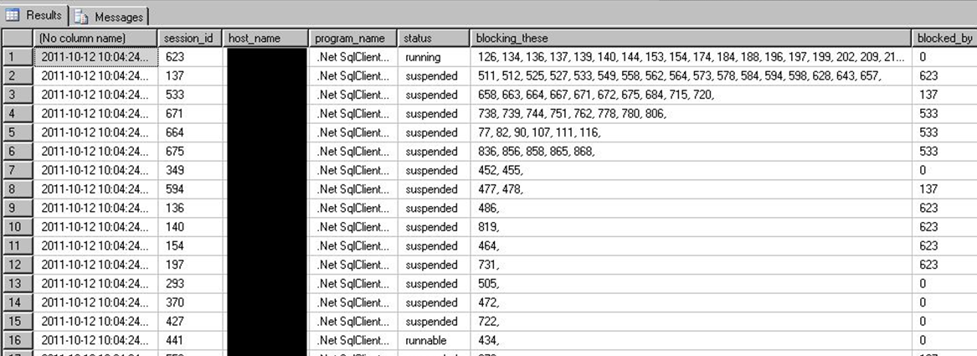
Sessions + Requests
Put them together for a status query far more detailed than SP_WHO2! Lab: sessions and requests.sql

Slide 38
sys.dm_exec_requests
Use the helpful percent_complete column to check progress of BACKUP and RESTORE.
Also applies to DBCC CHECKDB operations!
Combined with the start_time value, can estimate a completion datetime as well.
Lab:
Backup restore progress.sql

Slide 39
sys.dm_exec_input_buffer
DBCC INPUTBUFFER still not deprecated.
But has been effectively replaced by a new DMF sys.dm_exec_input_buffer.
This can display the last command issued from a session, even if there is no live request.

Slide 40
Index DMV’s YOU Should KNOW
Physical stats DMV’s:
Help you evaluate need for index maintenance
Missing Index DMV’s:
Help you design new indexes
Index Usage Stats DMV:
Helps you evaluate existing index usage
Notes:
Ok, let’s talk about indexes now.

Slide 41
sys.dm_db_index_physical_stats
Determine index fragmentation to do SQL-level defrag.
Root of all index fragmentation monitoring queries.
avg_fragmentation_in_pct shows logical fragmentation for indexes and extent fragmentation for heaps.
Replaces the functionality of DBCC SHOWCONTIG to an extent.
(that’s a pun, get it?)

Slide 42
sys.dm_db_index_physical_stats
Will still show tables without clustered indexes as index_id = 0, this is a HEAP.
Almost always, a heap is poor design or an oversight.
However, heap fragmentation isn’t meaningful.
Index_ID = 1 is the clustered index.
Index_ID >= 2 is every other index.

Slide 43
sys.dm_db_index_physical_stats
Avg_fragmentation_pct is a scale of 0 (not fragmented) to 100 (perfectly fragmented)
You may find it beneficial to perform maint for avg_fragmentation_pct > 10
But optimal pct may vary.
Find balance of meaningful performance protection and logged maintenance activity.
30%? 50%?

Slide 44
INDEX MAINTENANCE
ALTER INDEX … REORGANIZE replaces
old DBCC INDEXDEFRAG
ALTER INDEX … REBUILD replaces old DBCC DBREINDEX, also updates the statistics
ALTER INDEX … REBUILD ALL rebuilds all indexes on a table, also updates the statistics, but not recommended.

Slide 45
sys.dm_db_index_physical_stats
When to use?
Use while your application is in production to identify tables that are generating fragmentation over time.
Then, only perform index maintenance on individual indexes as needed, and then, potentially only on partitions of indexes.

Slide 46
Index Maintenance
Ideal: REBUILD ONLINE or REORGANIZE the top fragmented every maint window
Every maint window = nightly? weekly?
Custom scripts should use this selective approach.

Slide 47
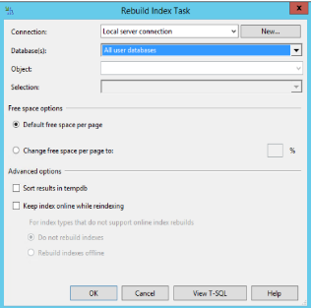
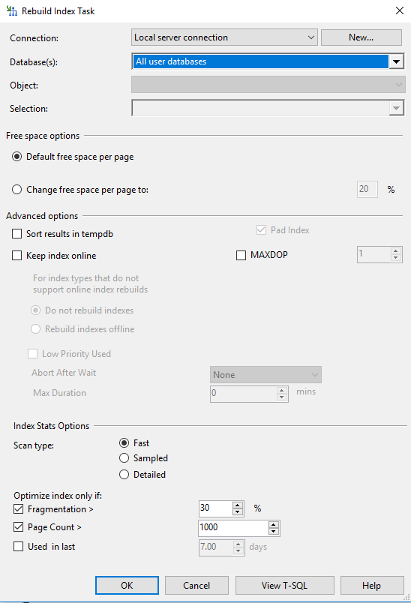
Index Maintenance
Rebuild Index Task
SQL 2014 vs SQL 2017
Notes:
SSMS Maintenance Plans since SQL 2016 have dramatically increased capability to perform complex, conditional index maintenance operations.
You can configure the REORGANIZE and REBUILD tasks to maintain only indexes filtered by percentage of fragmentation level, or page count.

Slide 48
sys.dm_db_index_physical_stats
MODE parameter options for Scan Depth:
LIMITED Fastest, default, only scans branch-level pages, not leaf.
Only returns basic metrics, leaves the rest NULL.
SAMPLED Not as fast, samples 1% of leaf pages.
DETAILED Much more involved. Scans all data pages.
Will hammer your IO subsystem.
Only way to get some of the columns to populate, but rarely needed.
Can still impact on performance on LIMITED mode.

Slide 49
sys.dm_db_index_physical_stats
Lab:
*lab - fragmented table.sql
*defrag.sql
automated index rebuild.sql
Notes:
<MUST DO THIS LAB>

Slide 50
Aside, on Fragmentation
Why did the Microsoft Windows 7 RC download page break?
http://www.sqlskills.com/BLOGS/PAUL/post/Why-did-the-Windows-7-RC-failure-happen.aspx
Notes:
See this still happening in Microsoft products, including CRM.

Slide 51
dm_db_column_store_row_group_physical_stats
Columnstore indexes have their own DMV for rowgroup status and fragmentation, sys.dm_db_column_store_row_group_physical_stats
You need to include this DMV in any of your maintenance scripts if you have Columnstore indexes (and you should, they’re awesome SQL 2016+!)
Since Columnstore indexes are read-only prior to SQL 2016, this wasn’t needed in SQL 2012 or SQL 2014.

Slide 52
dm_db_column_store_row_group_physical_stats
You may find it necessary to REORGANIZE a Columnstore index multiple times before the rowgroups are compressed and the deltastore rowgroups are moved to TOMBSTONE status.
Lab: Defrag Columnstore.sql

Slide 53
Missing Indexes Views
sys.dm_db_missing_index_groups
sys.dm_db_missing_index_group_stats
sys.dm_db_missing_index_details
Passive. Already running. Doesn’t need to be enabled.
Cleared out when the server is rebooted, also cleared out for a table when you alter the table or indexes on that table.
Only recommends nonclustered indexes.
Won’t recommend a clustered index on a heap, you have to fix that!
Won’t recommend columnstore, xml, spatial index types.
Notes:
<read notes first>
My favorite feature of introduced by SQL 2005.
A set of DMV’s record whenever a query plan recognized the need for an index that could have improved performance.
SQL records that recognized need, along with estimated statistics on cost and improvement of the new index.
<read slide>

Slide 54
Missing Indexes Views
Must be used with sobriety. Don’t create every suggested missing index or your update/insert/deletes will suffer.
Nonclustered Indexes exist physically as copies of your table, and must be kept up to date too, thus the overhead cost to every write.
However, writes can benefit from nonclustered indexes by making the source more efficient.

Slide 55
Missing Indexes Views
Indexes should be created to help many queries,
many index suggestions.
Suggestions may only differ only by the columns in the key vs. INCLUDE’d, or by a small number of columns.
1. Combine suggestions together with common key columns in the same order starting, and a combined INCLUDE list.
2. Combine with existing indexes on the table as well, potentially replacing an old index.
However, be careful not to change the uniqueness of the table. A unique index = a unique constraint.

Slide 56
Missing Indexes Views
When to use?
After recording actual usage in production.
Careful of use in development, may be misleading
Do use during user testing to simulate actual usage or production after typical activity.
Try to capture an entire business cycle (weekly payroll, month-end reporting, quarterly or annual, etc.)
Notes:
Try to understand the business cycle!

Slide 57
Missing Indexes - NEW in SQL 2019
sys.dm_db_missing_index_group_stats_query
Actually part of Query Store feature (introduced in 2016)
Returns the latest sql_handle and offsets
Find the latest query to generate the missing index need!
Notes:
Try to understand the business cycle!

Slide 58
Final Note on Missing Indexes Views
Since SQL 2008 – Missing index views have been integrated into the show query plan screens in SSMS.
But don’t use this to create new indexes. Very few queries are important enough to deserve their own indexes.
Take a look at the whole picture, including all suggested indexes and all existing indexes before creating any indexes.
Treat this as an alert!

Slide 59
Missing Indexes Views
Lab
*lab - fragmented table create missing index.sql
(re-uses fragmented tables)
*missing indexes.sql
(including new 2019 DMV query!)

Slide 60
sys.dm_db_index_usage_stats
Tracks access operations on all indexes and HEAPs, cumulatively.
Data resets with the instance, or if the database is detached.
Retains data through maintenance operations.
Joins to sys.indexes on object_id, index_id

Slide 61
sys.dm_db_index_usage_stats
How to use?
Look at writes vs reads
Zero user_lookups, user_seeks, user_scans (reads) = This index isn’t being read from.
User_updates (writes) greater than reads = This index might hurt more than it helps.

Slide 62
sys.dm_db_index_usage_stats
When to use?
Similar to the missing index DMV’s.
Use after a stable period of actual production use.
Try to capture a business cycle (weekly payroll, month-end reporting, quarterly or annual, etc.)
Lab: index_usage_stats.sql

Slide 63
Index DMV’s in Summary
Physical stats DMV’s:
Help you evaluate need for index maintenance
Missing Index DMV’s:
Help you design new nonclustered indexes
Index Usage Stats DMV:
Helps you evaluate existing index usage

Slide 64
DMV Rapid-fire ROUND BEGINS

Slide 65
sys.dm_os_performance_counters
Query Perfmon stats with T-SQL (not WSQL!)
Replaces the deprecated sys.sysperfinfo
Includes hundreds of “SQLServer:” related performance counters, including all instances.
Slightly more involved to read than the values out of perfmon
Notes:
For example, need to actually do some division between two rows to get the Buffer Cache Hit Ratio – a useful memory usage counter.

Slide 66
sys.dm_os_performance_counters
Lab
dm_os_performance_counters.sql
page life expectancy.sql

Slide 67
sys.dm_os_sys_memory
Includes total and available physical memory and cache levels, current page life expectancy, and more memory-related data.
Also flags for Low/High memory signals from Windows
Application can use to automatically scale itself up/down based on available server memory.

Slide 68
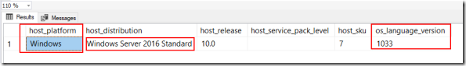
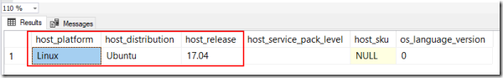
sys.dm_os_host_info
Host server information including version info for both Windows and Linux, new to SQL Server 2017.
In your inventory or diagnostic queries, replace sys.dm_os_windows_info.
Screenshots: https://sqlxpertise.com/2017/10/16/sys-dm_os_host_info-dmv-to-find-operating-system-information-in-sql-server-2017/

Slide 69
sys.dm_server_services
SQL Server instance service information, including the last time the service was started, SQL Agent’s status, IFI…
SELECT servicename -- SQL Server Instance name
, startup_type_desc -- Manual, Automatic
, status_desc -- Running, Stopped, etc.
, process_id
, last_startup_time -- datetime
, service_account
, filename
, is_clustered -- Y/N
, cluster_nodename
, instant_file_initialization_enabled -- SQL 2016 SP1+, 2012 SP4+ as well
FROM sys.dm_server_services
Notes:
Instant File Initialization used to be much harder to figure out if it was enabled, now it’s easy.

Slide 70
sys.dm_server_registry
SELECT
registry_key, value_name, value_data
FROM sys.dm_server_registry
WHERE registry_key like 'HKLM\Software\Microsoft\Microsoft SQL Server\%\MSSQLServer\Parameters'
value_name | value_data
SQLArg0 | -dE:\Program Files\Microsoft SQL Server\MSSQL14.SQL2K17\MSSQL\DATA\master.mdf
SQLArg1 | -eE:\Program Files\Microsoft SQL Server\MSSQL14.SQL2K17\MSSQL\Log\ERRORLOG
SQLArg2 | -lE:\Program Files\Microsoft SQL Server\MSSQL14.SQL2K17\MSSQL\DATA\mastlog.ldf

Slide 71
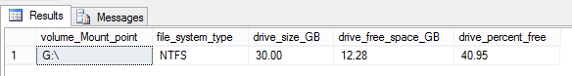
sys.dm_os_volume_stats
Bypass WMI calls – get physical drive size/available space from within SQL, join to sys.master_files.
Only shows volumes where SQL files are present.
For space on ALL disks, still have to use exec xp_fixeddrives
Lab:
volume stats.sql
job - Volume Stats Monitoring for Production.sql

Slide 72
sys.dm_DB_LOG_STATS
New for SQL 2016 SP2+ and SQL 2017
A handy DBA-friendly one-stop-shop dashboard of transaction log metrics including:
VLF size and counts
log reuse reason
backups
Use this instead of DBCC LogInfo (deprecated)

Slide 73
Sys.dm_io_virtual_file_stats
Includes an ascending counter that can be used to measure the data volume over intervals
For example:
Number of reads/writes issued to a file
Read/writes volume in bytes
IO waits/stall per file
overall IO latency for reads/writes
Lab:
record_dm_io_virtual_file_stats.sql

Slide 74
Sys.dm_OS_RING_BUFFERS
Access to ring buffer endpoints of XEvents sessions
The System Health session already gathers a lot of data, including a history of CPU, Memory utilization.
The default system_health xevent session the only way to find Deadlocks in the recent past without having set up anything to capture them, written to ring_buffer and .xel.
Lab:
sys_dm_os_ring_buffers.sql
deadlocks in xevents.sql
cpu utilization.sql

Slide 75
sys.dm_hadr_cluster
Returns information about Availability Groups
Not AlwaysOn cluster, not DAG… Availability Groups.
Doesn’t matter if primary or secondary, but many DMV’s require you to run on the primary replica for an AG to see complete information.
Also use sys.dm_hadr_cluster_members to see members.

Slide 76
sys.dm_hadr_cluster
Combine with Sys.dm_hadr_database_replica_states,
and sys.dm_os_performance_counters
for a performance snapshot of Availability Groups,
Including all current configuration, and endpoints
Including your current RPO/RTO (especially useful for asynchronous replicas) and last commits
Far more detailed than the SSMS AG dashboard
Lab:
AG - Monitor.sql

Slide 77
Sys.dm_db_page_info
New in SQL 2019, replaces most of DBCC Page
No need for trace flag 3604 to see data
DMF – can be joined to other DMO’s
Also new in SQL 2019, sys.fn_PageResCracker, which accepts a hexadecimal from sys.dm_exec_requests.page_resource if the wait_resource type is PAGE, to help you investigate.
So, it’s limited. Doesn’t return info for other wait_resource types, like KEY.

Slide 78
Helpful links, sources, and continued reading:
http://www.sqlskills.com/BLOGS/PAUL/post/Why-did-the-Windows-7-RC-failure-happen.aspx
http://technet.microsoft.com/en-us/library/cc966413.aspx
http://msdn.microsoft.com/en-us/library/ms188917.aspx
http://www.codeproject.com/KB/database/Dynamic_Management_Views.aspx
http://glennberrysqlperformance.spaces.live.com/blog/cns!45041418ECCAA960!1446.entry
http://sharmilasanctuary.wordpress.com/about/database-performance-dmvs-for-ms-sql-2005/
http://sqlblog.com/blogs/kevin_kline/archive/2009/04/07/looking-for-good-dmv-database-admin-queries.aspx
http://blogs.msdn.com/jimmymay/archive/2008/10/30/drum-roll-please-the-debut-of-the-sql-dmv-all-stars-dream-team.aspx
http://blogs.msdn.com/psssql/archive/2007/02/21/sql-server-2005-performance-statistics-script.aspx
http://msdn.microsoft.com/en-us/magazine/cc135978.aspx
http://www.sqlservercentral.com/articles/DMV/64425/
http://www.sqlskills.com/BLOGS/PAUL/post/Inside-sysdm_db_index_physical_stats.aspx
http://www.sqlskills.com/BLOGS/PAUL/post/Indexes-From-Every-Angle-How-can-you-tell-if-an-index-is-being-used.aspx
http://kswain.blogspot.com/2008/04/sysdmosperformancecounters-dynamic.html
http://www.sqlpassion.at/archive/2014/11/24/deadlocks-caused-by-missing-indexes-in-sql-server
http://www.sql-server-performance.com/articles/per/bm_performance_dashboard_2005_p2.aspx
http://msdn.microsoft.com/en-us/library/aa366541%28VS.85%29.aspx
http://sqlblog.com/blogs/aaron_bertrand/archive/2011/04/25/more-changes-you-might-not-have-noticed-in-the-sql-server-2008-r2-sp1-ctp.aspx
http://www.sqlskills.com/BLOGS/PAUL/category/Spinlocks.aspx
https://docs.microsoft.com/en-us/sql/relational-databases/system-dynamic-management-views/sys-dm-db-log-info-transact-sql?view=sql-server-2017
https://www.sqlshack.com/sql-server-2019-new-dmf-sys-dm_db_page_info/

Slide 79
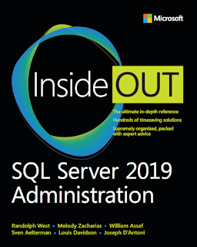
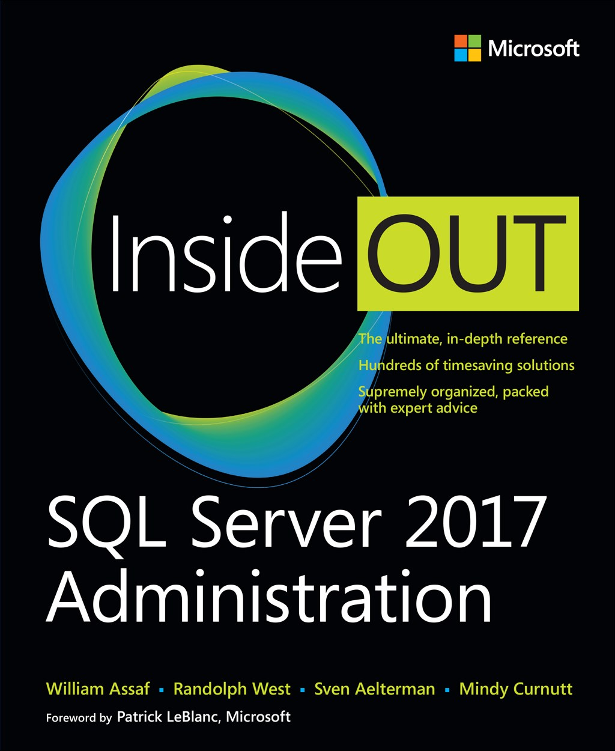
SQL Server 2017 Inside Out
SQL Server 2019 Administration Inside Out
by Microsoft Press
2017 published Feb 2018
2019 published March 2020

Slide 80

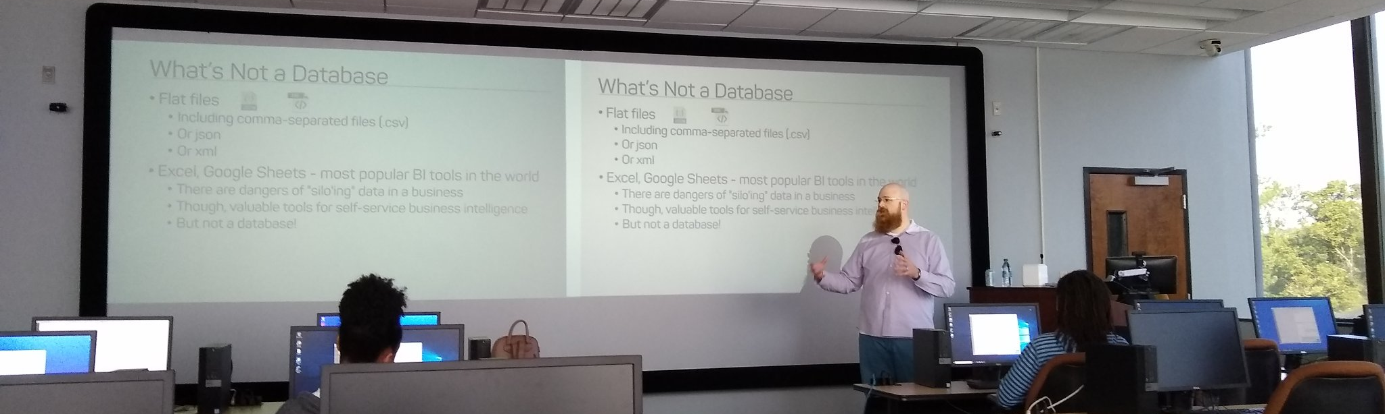
Support your Local STEM Initiatives
I encourage you to find, then donate time and money to local STEM education initiatives where you live. Get involved!
There is almost certainly some nonprofit where you live that needs your enthusiasm and skills to close the achievement gap.
https://www.thewallsproject.org/programs/futures_fund/
Notes:
Here’s a STEM education nonprofit local to me that I volunteer for, please reach out and share your knowledge with the next generation, and especially with folks in your community that are needing to find new careers during the pandemic.

Slide 81


William Assaf
Former Principal Consultant, Former Microsoft MVP Data Platform
Former PASS Regional Mentor, Former SQLSaturday and UG Co-Organizer in Baton Rouge, La., USA.
Senior Content Developer, SQL-Docs
Microsoft
SQLTact.com
Co-author, Microsoft Press SQL Server Administration Inside Out 2017 and 2019. Former MS Cert writer.
linkedin.com/in/williamdassaf
@william_a_dba
Notes:
This presentation is available for download at my blog SQLTact.com.

